Slide 1
Overview of classical ML: classification methods and decision trees
Cong Ma
Notes:
\DeclareMathOperator*{\argmin}{\arg\min}
\DeclareMathOperator*{\argmax}{\arg\max}

Slide 2
Statistical models for classification
So far, we have focused on regression, e.g., with least-squared loss
Are there natural statistical models for classification?
Can have {0,1}, {1,2, …, K}

Slide 3
Risk in classification
In classification, risk is

Slide 4
Bayes‘ optimal classifier
Assuming the data is generated iid according to
The hypothesis h* minimizing is given by the most probable class
This hypothesis is called the Bayes’ optimal predictor for the classification loss
Thus, natural approach is again to estimate P(Y|X)

Slide 5
Natural estimator for P(Y|X)
Fix some x in X
Find out all x_i that are equal to x; suppose we have m such samples
A natural estimator would be
What’s the problem of this?

Slide 6
Overview of classical ML: classification methods and decision trees
Logistic regression
Cong Ma
Notes:
\DeclareMathOperator*{\argmin}{\arg\min}
\DeclareMathOperator*{\argmax}{\arg\max}

Slide 7
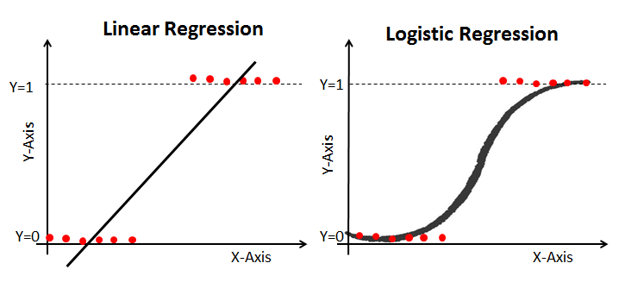
We need a model for P(Y=1 | X = x)
What about a linear model?

Slide 8
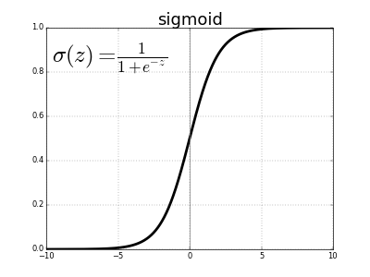
Link function for logistic regression
Link function

Slide 9
Logistic regression
Logistic regression (a classification method) replaces the assumption of Gaussian noise (squared loss) by independently, but not identically distributed Bernoulli noise:

Slide 10
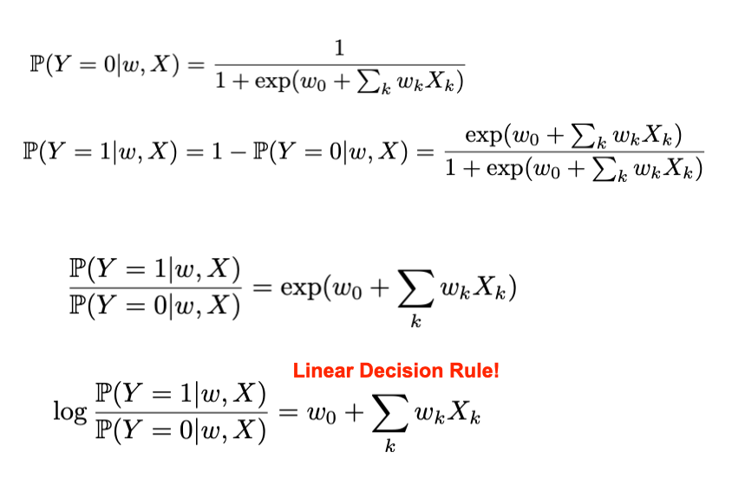
Key observation
Decision boundary is linear!
What’s the decision boundary?
Why is it linear?

Slide 11
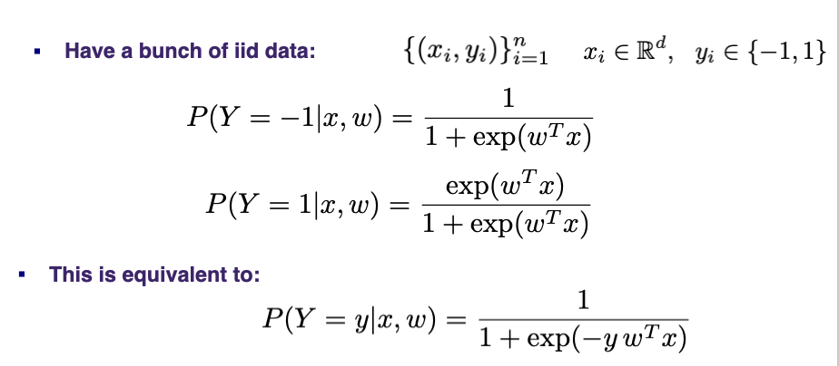
How to fit logistic regression

Slide 12
MLE for logistic regression
Negative log likelihood (=objective) function is given by n
The logistic loss is convex! → optimization with (stochastic) gradient descent

Slide 13
Logistic loss (log loss)

Slide 14
Gradient for logistic regression
Loss for data point
Gradient

Slide 15
Optimization: logistic regression
Initialize w
For t = 1, 2, ... do
Pick data point (x, y) uniformly at random from data D
Compute probability of misclassification with current model
Take gradient step

Slide 16
Logistic regression and regularization
Use regularizer to control model complexity
Instead of solving MLE
Estimate MAP/solve regularized problem
L2 (Gaussian prior)
L1 (Laplace prior)

Slide 17
Extension to multi-class logistic regression
Maintain one weight vector per class and model
Not unique – can force uniqueness by setting w_1 = 0
this recovers logistic regression as special case
Corresponding loss function (cross-entropy loss)

Slide 18
Illustration: logistic regression 3-class classifier
Dataset (Iris Data Set) and demo code: https://bit.ly/3bJ98CQ

Slide 19
STAT 37710 / CMSC 35400 / CAAM 37710 Machine Learning
Generative Models for Classification
Cong Ma
Notes:
Latex Macros
\def\MSE{{\mbox{MSE}}}
\def\sign{{\mbox{sign}}}
\def\iid{{\mbox{iid}}}
\def\siid{\stackrel{\mbox{\footnotesize iid}}{\sim}}
\def\Bias{{\mbox{Bias}}}
\def\Var{{\mbox{Var}}}
\def\var{{\mbox{var}}}
\def\Unif{{\mbox{Unif}}}
\def\Cov{{\mbox{Cov}}}
\def\cov{{\mbox{cov}}}
\def\poly{{\mbox{poly}}}
\def \eg{{ e.g.\ }}
\def \ie{{ i.e.\ }}
% ----------------------------------------------------------------
% Functions and Functionals
% ----------------------------------------------------------------
\newcommand{\indic}[1]{\mathbbm{1}\left[#1\right]}
\renewcommand{\Pr}[1]{\ensuremath{\mathbb{P}\left[#1\right] }}
\newcommand{\expct}[1]{\mathbb{E}\left[#1\right]}
\newcommand{\expctover}[2]{\mathbb{E}_{#1}\!\left[#2\right]}
\newcommand{\PrOver}[2]{\ensuremath{\mathbb{P}_{#1}\!\left[#2\right]}}
\newcommand{\abs}[1]{\left\vert#1\right\vert}
\newcommand{\smoment}{\hat{m}}
\newcommand{\tmoment}{M}
\newcommand{\moment}{m}
\newcommand{\obs}{z}
\newcommand{\mmap}{M}
\DeclareMathOperator*{\MAD}{\mbox{MAD}}
\DeclareMathOperator*{\med}{\mbox{median}}
\DeclareMathOperator*{\tr}{\mbox{tr}}
\DeclareMathOperator*{\argmin}{\arg\min}
\DeclareMathOperator*{\argmax}{\arg\max}

Slide 20
Discriminative modeling
Discriminative models aim to estimate conditional distribution
Generative models aim to estimate joint distribution
Can derive conditional from joint distribution, but not vice versa.

Slide 21
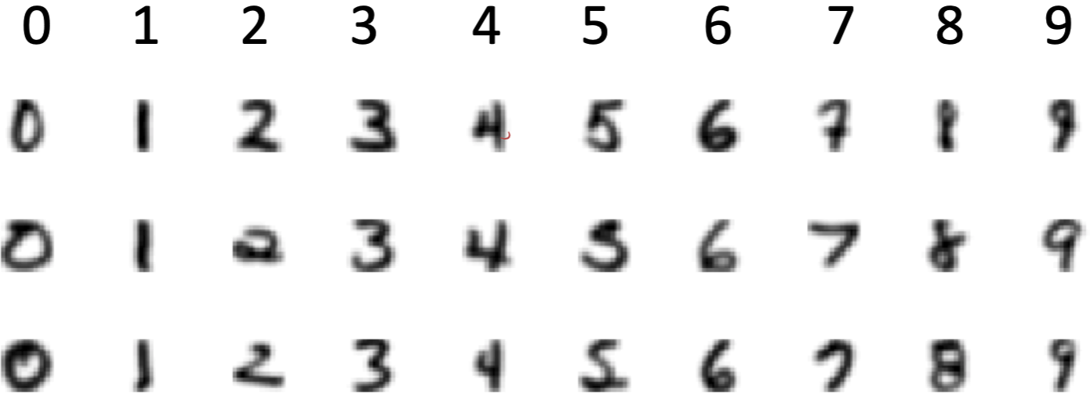
Typical approaches to generative modeling
Estimate prior on labels P(y)
Estimate conditional distribution P(x | y) for each class y
Obtain predictive distribution using Bayes’ rule: P(y | x) = P(y) P(x | y) / Z
Example: hand-written digits

Slide 22
Gaussian Bayes classifiers (GBC)
Model class label as generated from categorical variable
Model features as multivariate Gaussians
How do we estimate the parameters?

Slide 23
MLE for GBC
Given data
MLE for class label distribution
MLE for feature distribution:

Slide 24
Discriminant functions for GBC
Given ;
GBC is given by

Slide 25
Fisher’s linear discriminant analysis (LDA), c = 2
Suppose we fix
Further, assume covariances are equal:
Then the discriminant function for GBC could be simplified as

Slide 26
Fisher’s LDA
Assuming
binary classification
equal class probabilities
equal covariances
Fisher's LDA predicts
where and

Slide 27
LDA vs logistic regression
Fisher’s LDA uses the discriminant function
Therefore, the class probability of LDA is
This is of the same form as logistic regression.

Slide 28
Fisher’s LDA vs logistic regression
Fisher’s LDA
Generative model, i.e., models P(X,Y)
Assumes normality of X
not very robust against violation of this assumption
Logistic regression
Discriminative model, i.e., models P(Y | X) only
Makes no assumptions on X
More robust

